Slide 1
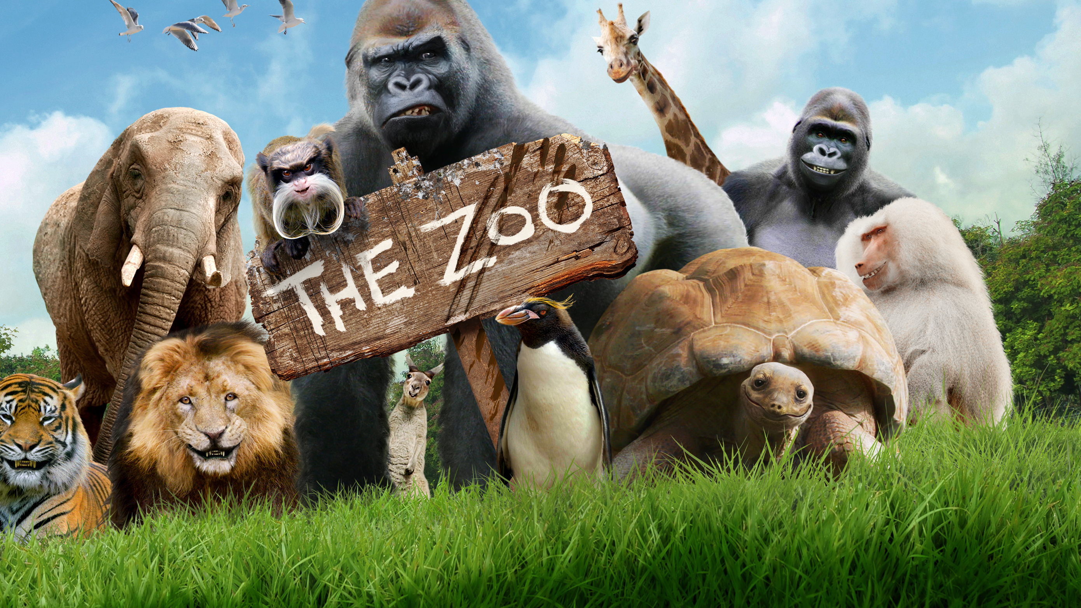
CyberZoo II
By Karina & Li
2024-03-05

Slide 2
Agenda
Tasks
Diagrams
Demonstration

Slide 3

Tasks
Define Routine and Staff
Manage Animal Routines
Tracking & Logging Activities
Frontend Server with React

Slide 4
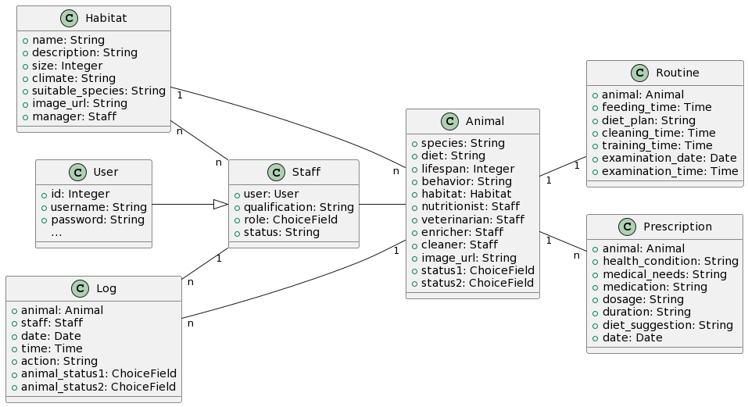
Class Diagram

Slide 5
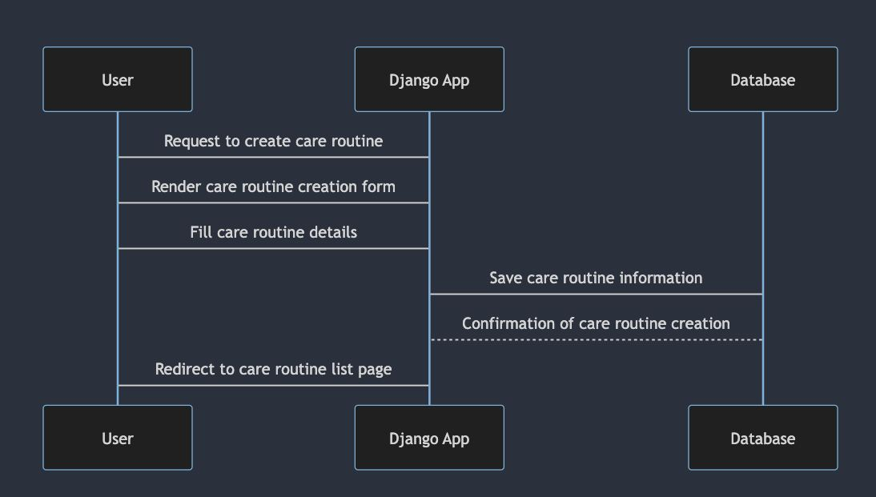
Create Routine

Slide 6
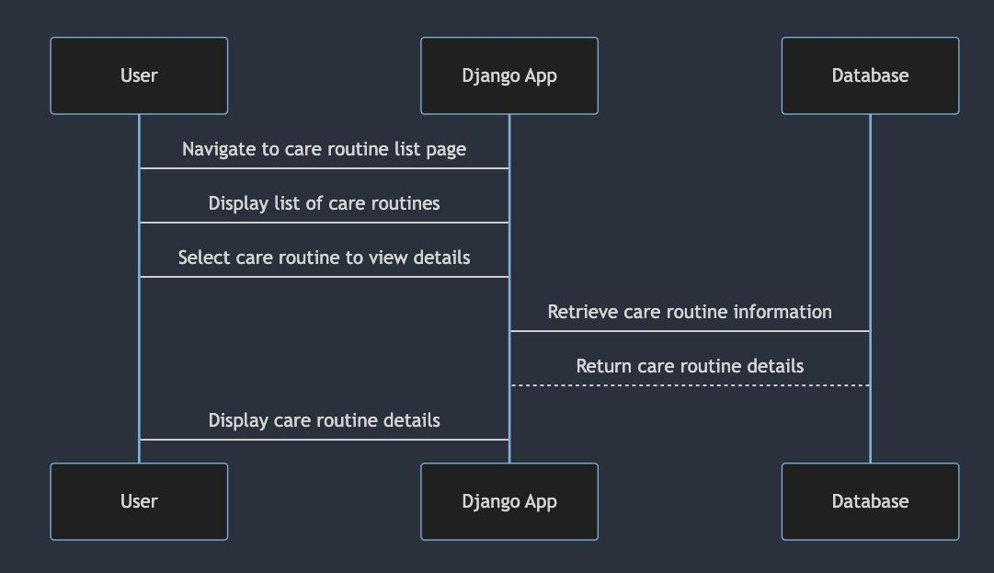
Retrieve Routine

Slide 7
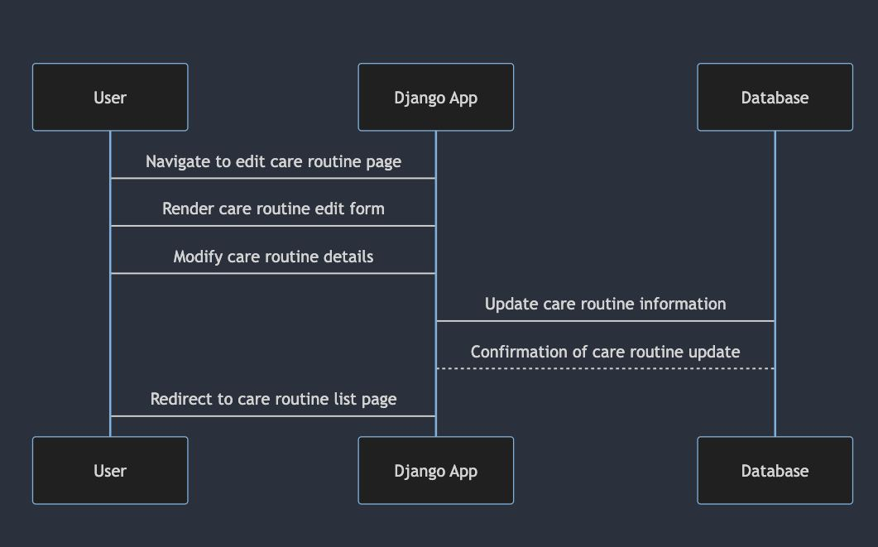
Update Routine

Slide 8
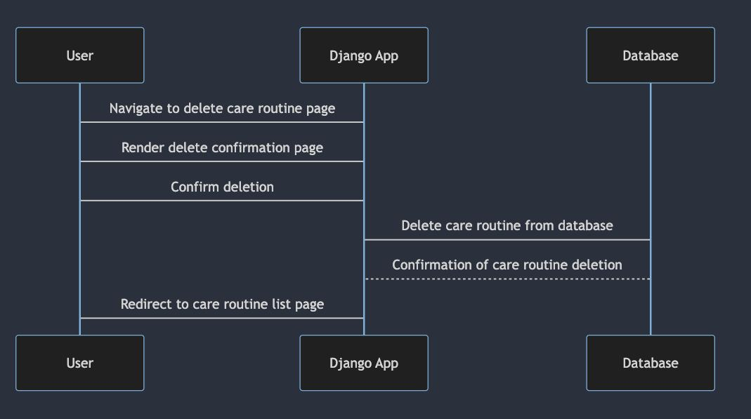
Delete Routine

Slide 9
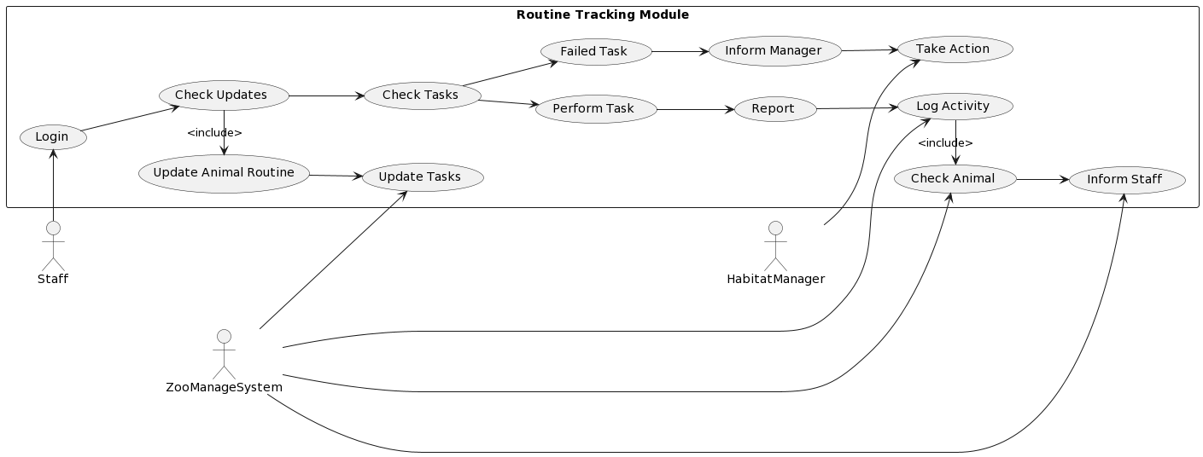
Tracking & Logging Use Case Diagram

Slide 10
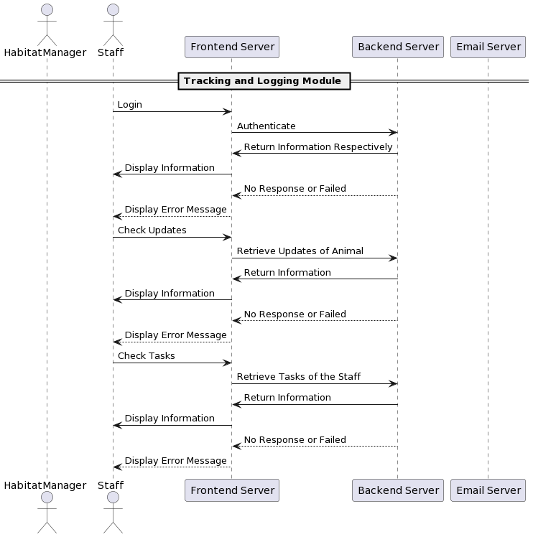
Tracking & Logging Sequence Diagram I

Slide 11
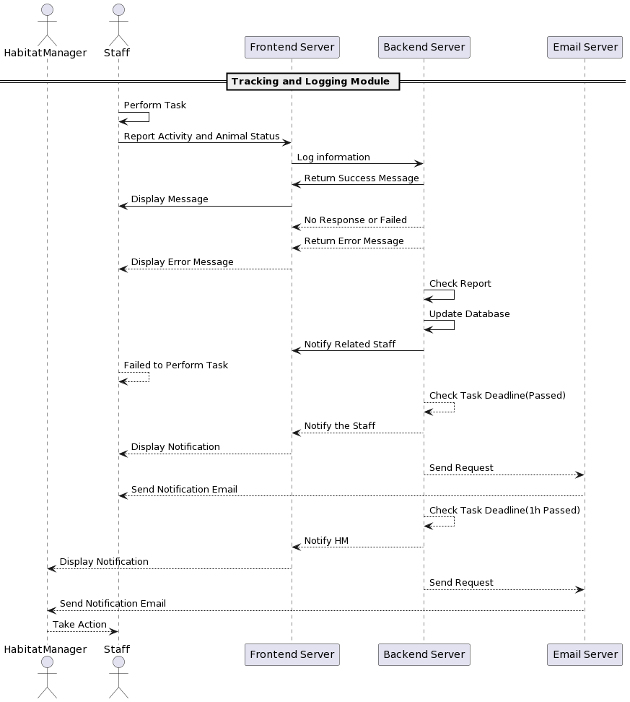
Tracking & Logging Sequence Diagram II

Slide 12
Please See Demonstration

